Slide 1
Poornima Dore Role and Contribution of NGOs
Urban Planning and Governance
January 2013

Slide 2
Key Players
Private Sector
Public Sector
Civil Society
Roles, domain and contribution
Especially in a democratic society

Slide 3
Civil Society
Includes society at large
Unions
Cooperatives
Community based organisations (CBOs)
Non Government Organisations (NGOs)
Charitable Societies
Trusts

Slide 4
Various Roles
Designing and Piloting Models
Making Planning more Inclusive
Garnering Public Voice on Neglected Issues
Bridging Information Gaps
Strengthening Governance and Accountability

Slide 5
Contribution - Examples
AMUL – a market based milk cooperative
SHG movement
Watershed development
Universal education
Right to Information Act
Disclosure of assets

Slide 6
SN | Portfolio | Model | Extent of current reach
1 | Urban poverty and livelihoods | Migration services | 100000 seasonal migrant workers through 34 NGOs
2 | Natural resources management | System of rice intensification | 169000 farmers through 98 NGOs
3 | Natural resources management | Diversion based irrigation | 18210 families through 34 NGOs
6 | Education | Women Literacy through SHG | 40000 women through 15 NGOs
9 | Civil Society | Empowerment of rural women | 108000 households in 9 districts
10 | Health | Community based malaria control | 30000 persons through 10 NGOs

Slide 7
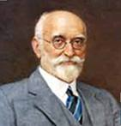
Sir Dorabji Tata Trust and Allied Trusts
The Promoter’s shareholding of the Tata Group is vested in the Trusts
66%
Tata Trusts
Varied
Tata Sons
Tata Group Companies
Unique Principle – Promoter’s dividend income from business operations must be used for development related activities – to give back to the community

Slide 9
Priority Areas within the Trust
The following have emerged as focus sub-themes :
NRML | UPL | Edu | Health | CSHRG | MAC
Household food security | Urban Planning & governance | Elementary Education | Hospital Infrastructure | Women’s empowerment | Art scholarship
Market led livelihoods | Migration | Adolescent Education | Community Health | Entitlements of the poor | Archives
Production Infrastructure | Informal sector workers | Child Protection | Disability | Prison work and rights | Endangered culture
Ecological Security | Employability | Women's education | Mental Health | Civil society building | Innovative media
NRML – Natural Resource Management and Livelihoods, UPL – Urban Poverty and Livelihoods,
CSHRG – Civil Society, Human Rights and Governance, MAC – Media, Art and Culture,

Slide 10
Urban Issues
Increasing Urbanisation
Cities as engines of growth
Concentration of opportunities
Readiness of cities to handle the load
Displacement of poverty
Slow shift in development discourse towards urban poverty

Slide 11
Urban Issues
Growing Urbanization and its challenges
Housing and shelter
Water and sanitation
Health
Education
Social security
Livelihoods
Visibility, security and acceptance

Slide 12
Planning and Governance
Livelihoods Support for Relocated Families in Savda Ghevra (Delhi) through the Centre for Urban and Regional Excellence— CURE
Enabling a City-wide Sustainable Relocation Policy in Sangli through Shelter Associates.
Towards More Just and Sustainable Redevelopment of Dharavi (Mumbai), through the Society for Promotion of Area Resource Centres -SPARC
Three such projects supported by Sir Dorabji Tata Trust
and Allied Trusts

Slide 13
All the projects involve work with communities who are already relocated or are under threat of relocation
All the interventions involve relocation as a beginning point and converting it to a meaningful opportunity for a more secure and legal life in the city.
nuanced resistance
technique of mapping to evolve more rational and just decisions
engaging with a range of governing institutions to press for more inclusion.

Slide 14
Case Study: CURE
Savda Ghevra
One of the largest resettlement colonies in Delhi
Expected to absorb 21,000 households
Sanjha Prayas program : pro-poor governance
Did not include the component of recreation of livelihoods

Slide 16
Case Study: CURE
Trusts initiated a complementary program in 2008—2009
Value chain analyses on home based work, identification of possible products, skill training certification
Establishment of community groups.
The bag making group involves about 30 women and is in the process of establishing itself and is expanding product range.
A screen printing group of 6-8 members has formally established itself with bank accounts and PAN Cards.
The proposal for a bakery products unit has been developed.

Slide 17
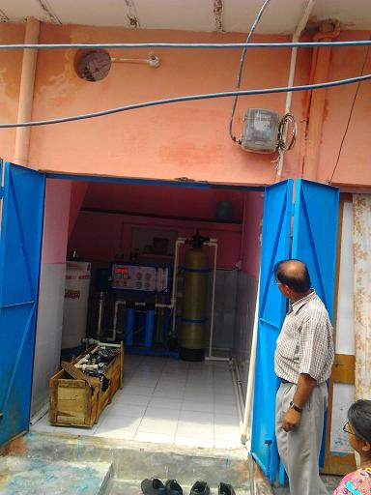
Case Study: CURE
Vermicomposting Water Kiosk

Slide 18
Case Study: CURE
A Livelihood Revolving Fund (LRF) was capitalized out of the project grant with the objective of creating access to financial resources to the urban poor.
The LRF provides small and multiple interest-free credits to enterprise groups to set up, operate, sustain and build up small businesses.
The credit money is available for the procurement of a. equipment for production and b. for raw material and is returned back to the LRF so that it can be revolved to other business enterprises.

Slide 19
Conclusion
Active role in creating alternate livelihood options
Facilitating access to transport networks
Creating water and sanitation facilities
Inputs in housing design and finance
Pre-resettlement mapping of locations and livelihoods
Piloting innovative market based solutions for the poor
Key partner in making government programs work by scaling up workable solutions in a participatory manner.

Slide 20
Thank You
Poornima.dore@sdtatatrust.com

